Slide 1
Bank Marketing Campaigns
Classifying Customer Responses
A. Sardina-Spevack Module 3 Project

Slide 2

Tested different models for classifying customer behavior

Slide 3

Term Deposit Direct Marketing
The Question:
Which group did our customers fall into at the end of the initiative:
-yes — subscribed
-no — did not subscribe

Slide 4
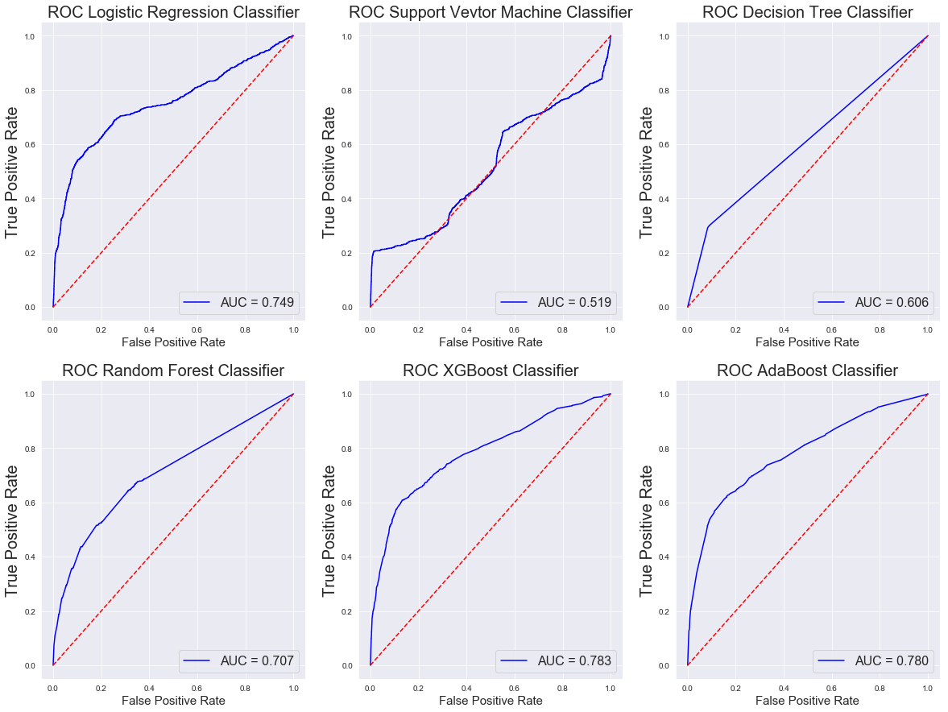
Model Selection
Six models were tested for their accuracy in correctly classifying customer behavior.
Logistic Regression
Support Vector Machine
Decision Tree
Random Forest
XGBoost
AdaBoost

Slide 5
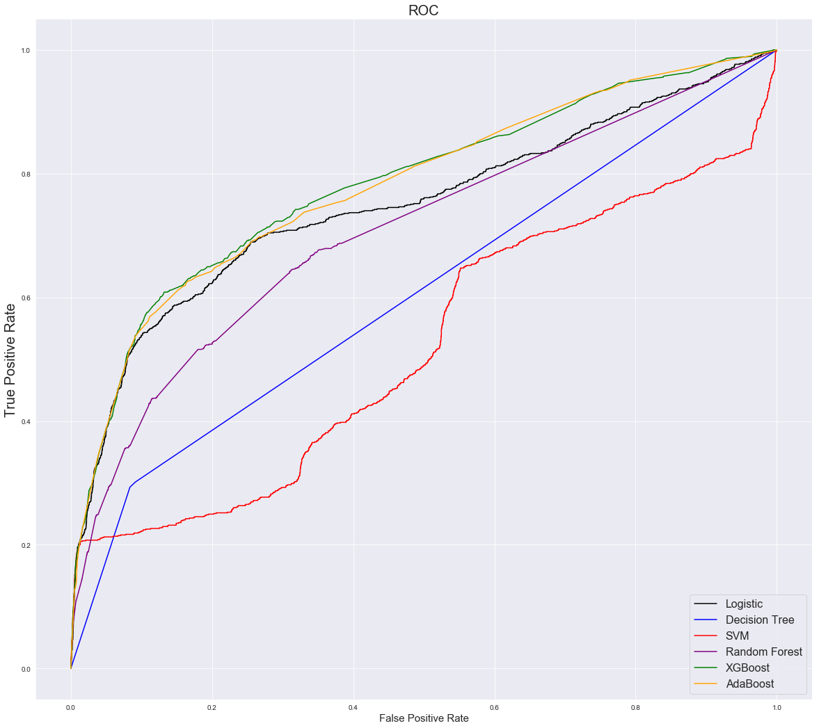
Comparative performance
Two Best Performing Models:
XGBoost:
Precision :70.8812%
Recall: 19.4737%
F-1: 30.5533%
AdaBoost:
Precision :68.5714%
Recall: 20.2105%
F-1: 31.2195%
Notes:
5%, 10%, 15%, 20%, 25%

Slide 6

Business Insights
The campaign led to 4,640 new term loans out of the 41,188 customers contacted, or 11.3% success rate
XGBoost can correctly predict more than 73% of the time that a customer has signed up for the term deposit.
Provide a lense into the profitability of future campaign with over a 78% accuracy
XGBoost is scalable and was developed with model accuracy and computational speed in mind

Slide 7
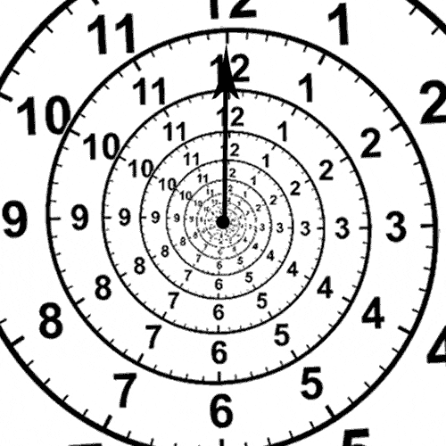
Possible Future Analysis
If we had additional time to research…
...full analysis on the dataset that includes duration
...address duration for only subscribed customers in a regression analysis to see if we can predict sign-up based on call time
...weigh computational efficiency against accuracy by removing the feature selection from the analysis

